Slide 1
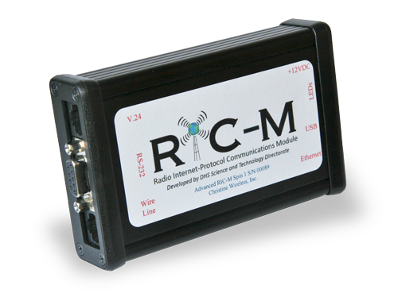
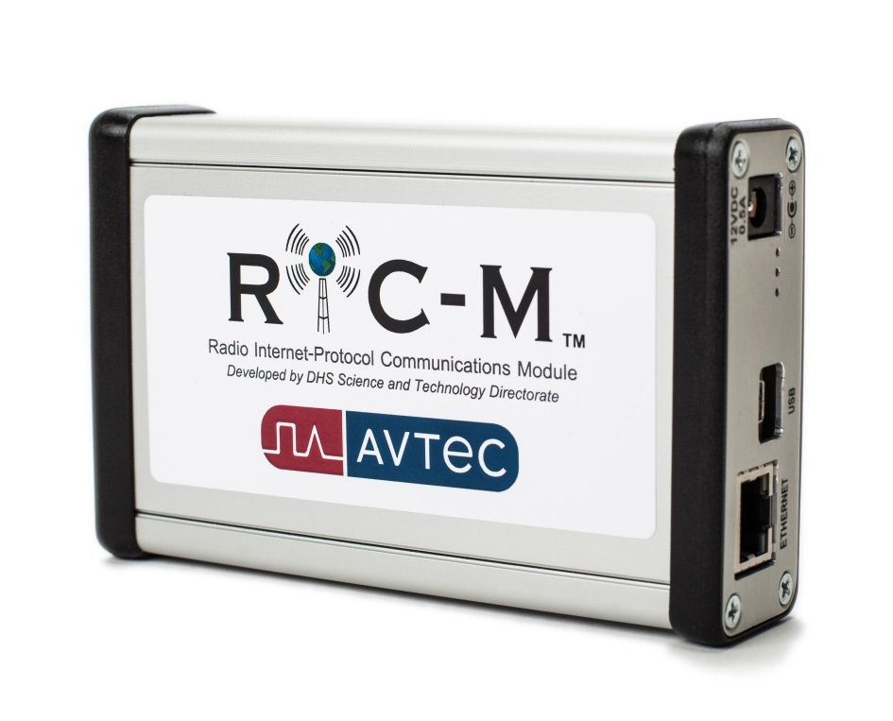
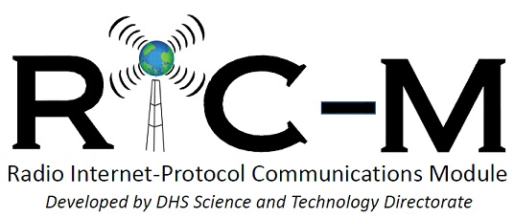
The Benefits of Migrating to an Internet-Protocol Based System
Presented by Richard Brockway
Christine Wireless, Inc.

Slide 2
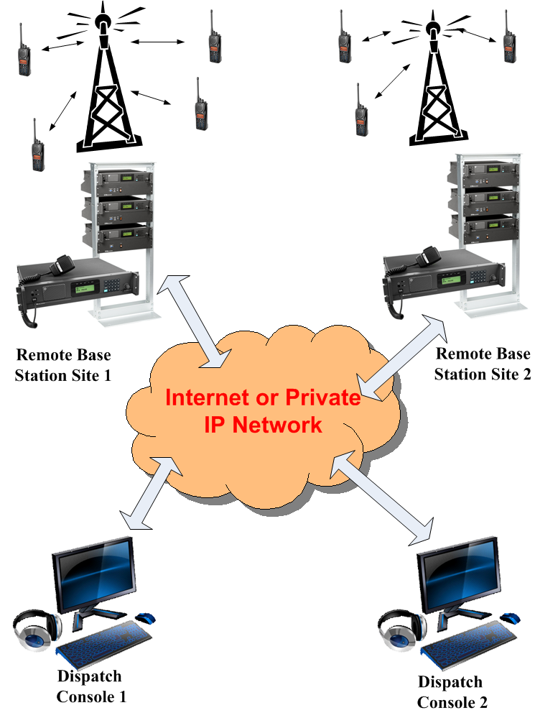
Internet-Protocol Connected System

Slide 3
Benefits of IP Based Systems
Interoperability (frequency bands, manufacturers, technologies)
Scalability-Very small through very large systems
Flexibility/Rapid re-configurability (Incident response)
Cover a wide geographic region
Economy (low cost IP circuits)
Enhanced security
Enhanced reliability

Slide 4
Difficulties in Migrating to an IP-Based System
Most currently installed legacy equipment is not IP-capable or upgradable to IP-total replacement required
Most current IP-Based solutions are manufacturer proprietary-once you pick the solution you can only buy from that manufacturer
Most current IP-Based solutions are expensive
Solution: Radio Internet-Protocol Communications Module (RIC-M)

Slide 5
How RIC-M Facilitates Migration to an IP-Based System
RIC-M provides an IP gateway for currently installed legacy Motorola Astro™ Conventional and analog equipment-reuse current equipment, not replace it
RIC-M uses TIA-standard IP and interoperates with equipment from multiple Dispatch Console and Base Station manufacturers-freedom on vendor selection for future equipment
RIC-M supports phased migration to IP while maintaining interoperability with installed legacy systems
Installed legacy equipment has several more years of useful life-defer equipment replacement while enjoying the benefits of IP based communications
RIC-M puts the radio system owner back in control
of the migration process

Slide 6
RIC-M Overview
RIC-M is an external after-market protocol converter: Converts Motorola Conventional ASTRO™ V.24 serial communications into Project 25 standard Internet-Protocol.
RIC-M interoperates with multi-vendor Project 25-capable Dispatch Consoles.
RIC-M can also connect with another RIC-M over IP without a Dispatch Console (autonomous mode).
RIC-M handles analog, digital voice (encrypted and unencrypted), Packet Data, TSBKs as well as remote control commands.
RIC-M is configured via a web browser over IP and firmware can be updated remotely over IP.

Slide 7
RIC-M History
Concept addresses a requirement identified by the Department of Interior Radio Laboratory in Denver Colorado in early 2011.
Department of Homeland Security Science and Technology Directorate funded development effort in November 2011.
First demonstration of concept at DOI Radio Lab in August 2012.
DHS Operational Field Assessment test at DOI Radio Lab in November 2013.
Final Delivery of design (Tier 1 IPR) to DHS in December 2013-Intellectual Property Rights (IPR) owned by DHS.
March 2015 Christine Wireless, Inc. receives license agreement under a CRADA for manufacture and sale of RIC-M from DHS.
DHS RIC-M demonstration at IWCE in March 2015.
July 2015 Avtec, Inc. receives license agreement under a CRADA for manufacture and sale of RIC-M from DHS.
DHS RIC-M demonstration at APCO in August 2015.

Slide 8
RIC-M Applications
Elimination of expensive and hard to get copper telephone circuits to interconnect Conventional Motorola ASTRO™ system elements.
Allow addition of non-Motorola base stations (e.g. Codan, ICOM) and other equipment into a Conventional Motorola ASTRO™ system.
Use non-Motorola Dispatch Consoles with a Conventional Motorola ASTRO™ system. Dispatch consoles from Avtec, Catalyst, Telex-Bosch, Moducom and Zetron
Re-location of elements of a Conventional Motorola ASTRO™ system to diverse locations using IP connections.
Applicable Products: Quantar™, GTR-8000™, PDR-3500™, ASTRO-TAC 3000™, DIU-3000™and TXM 2000™.

Slide 9
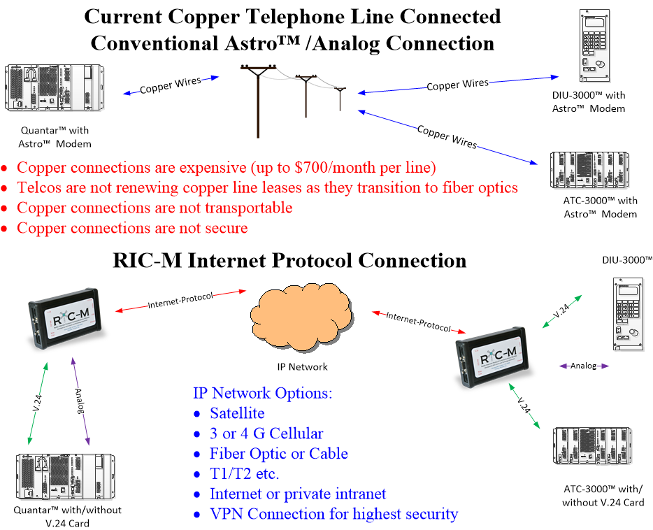
Replace Copper Connections

Slide 10
RIC-M Capabilities
• Digital Project 25 voice (Encrypted and unencrypted)
• Analog Voice (4 wire E&M)
• Confirmed and Unconfirmed Project 25 data including Over- the-Air-Rekey (OTAR) messages
• Virtual Com port for remote Radio Service Software (RSS) application via Internet-Protocol
• Remote Control of connected Base Station equipment
• Conventional Control and Signaling (TSBKs)
• Authenticated Remote Firmware Update via Internet-Protocol
• Connects to Conventional Motorola ASTRO™ system elements with and without V.24 board.
• Interconnects via Internet, private intranet, satellite, cellular and Virtual Private Networks (VPN).
• Web-based (browser) setup and monitoring

Slide 11
Project 25 TIA Standards
RIC-M is compliant with the Project 25 TIA-102.BAHA published standard.
RIC-M also incorporates Project 25 TIA Draft Standards for:
  Packet Data
  TIA-102.BAHA-A

Slide 12
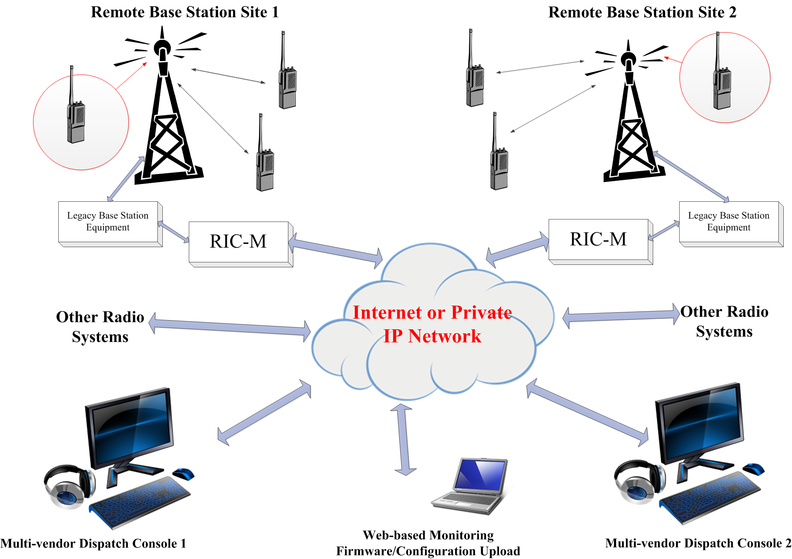
RIC-M Network Application

Slide 13
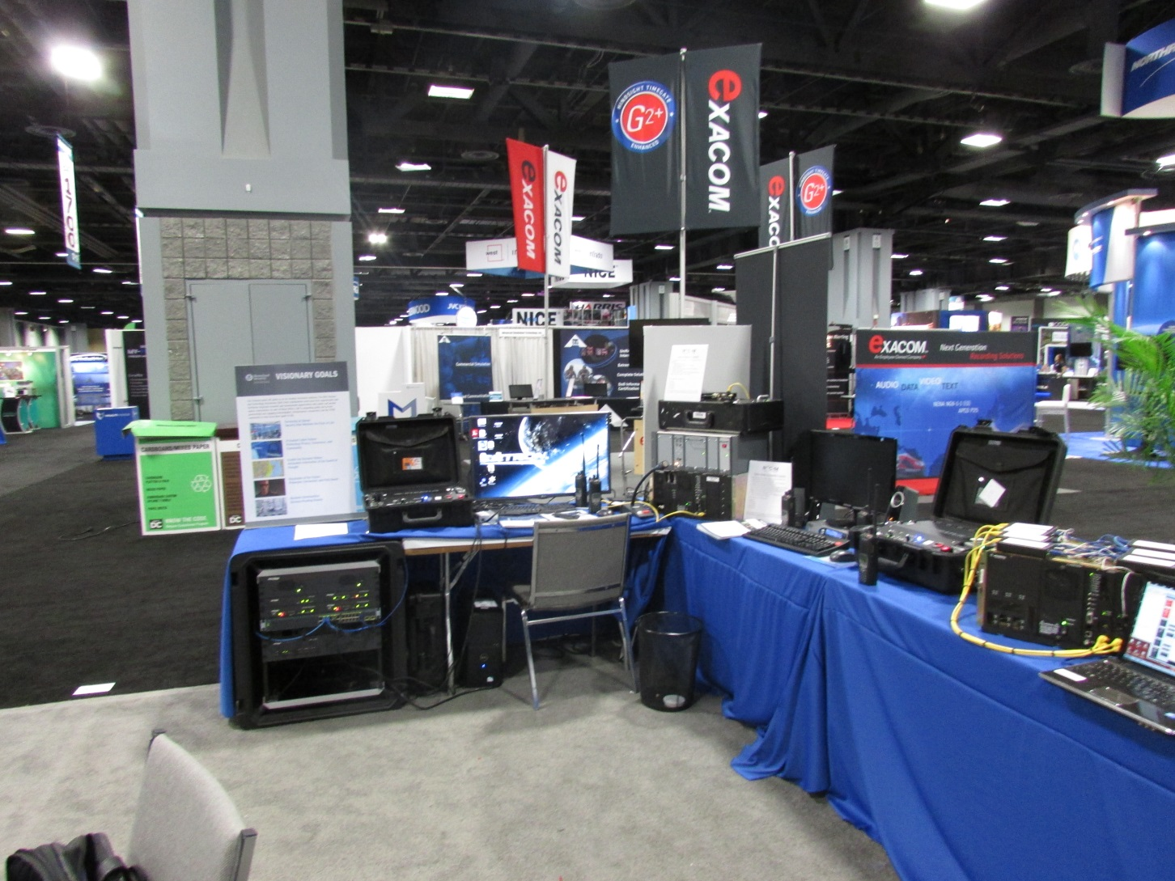
PDR-3500™/Codan Base Station/Zetron Console with RIC-M

Slide 14
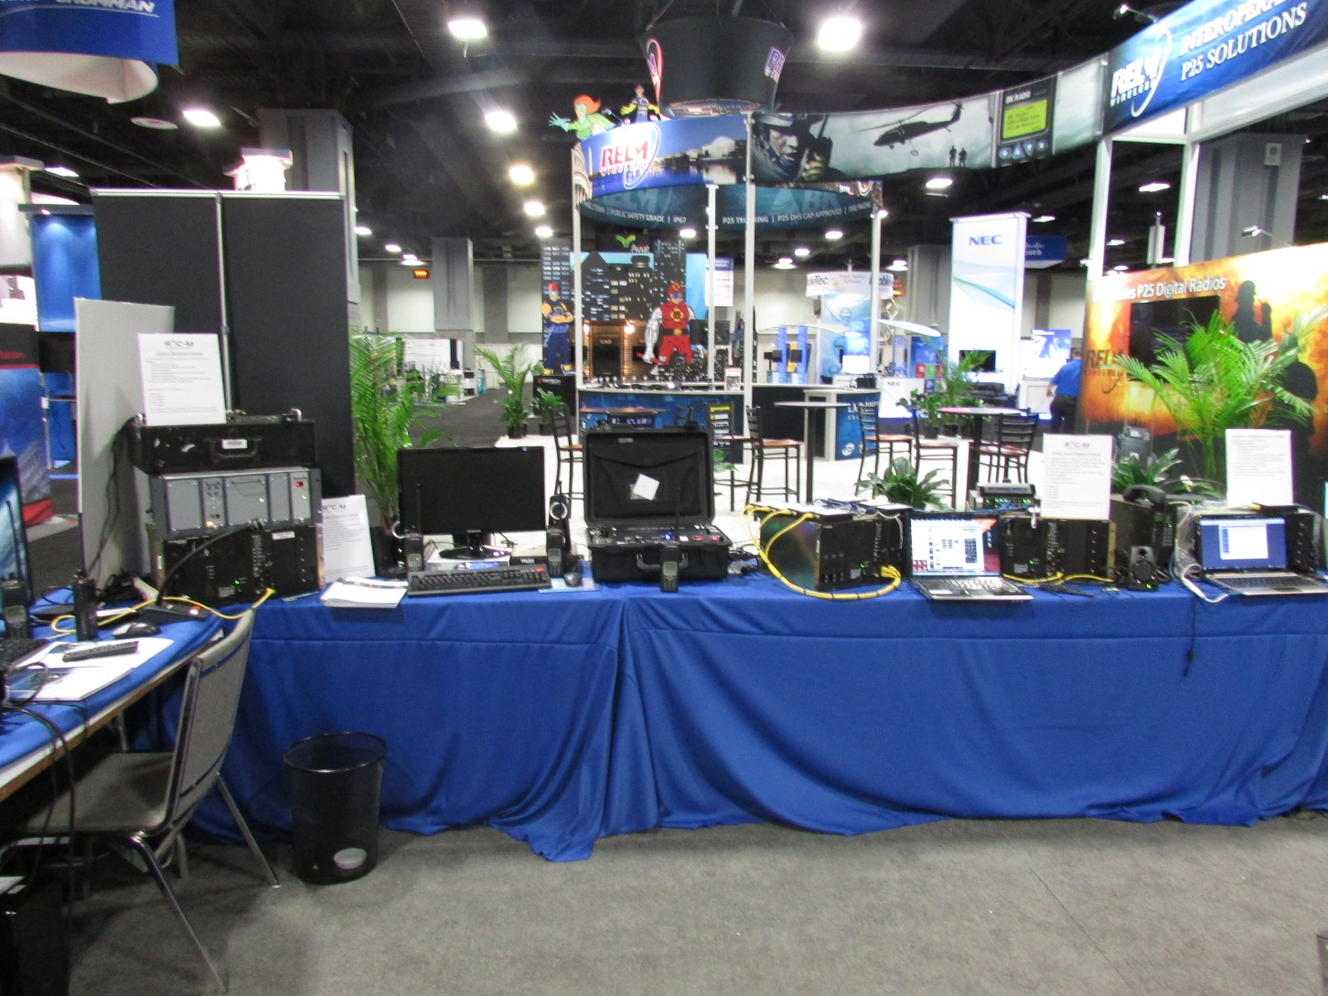
Quantar™/Codan Base Station/Telex-Bosch Dispatch Console/RIC-M

Slide 15
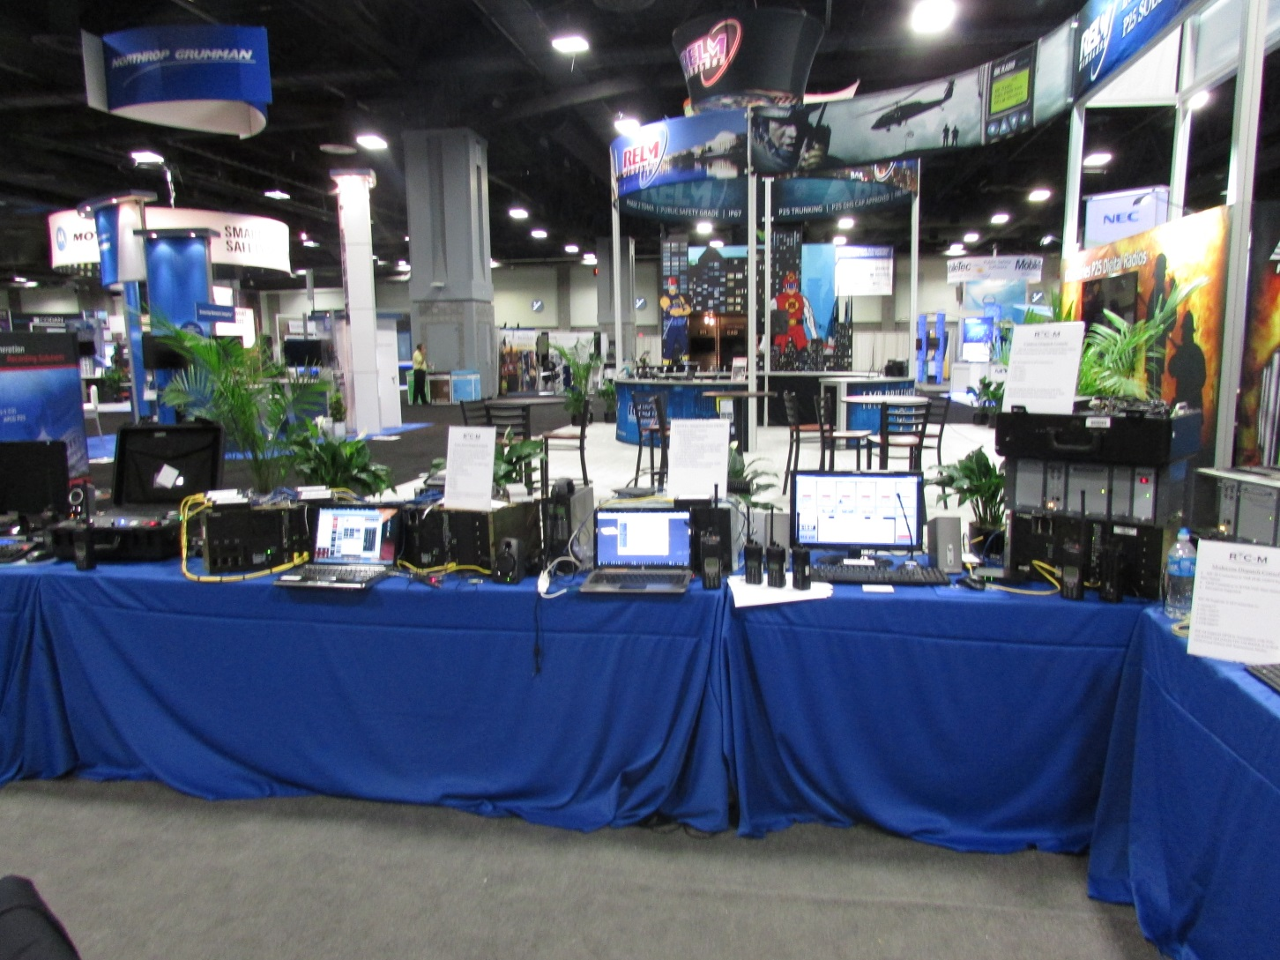
PDR-3500™/ICOM Base Station/Catalyst Dispatch Console/RIC-M

Slide 16
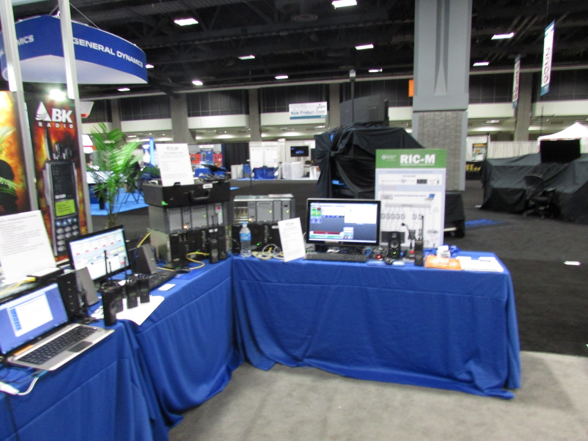
Quantar™/ICOM Base Station/Moducom Dispatch Console/RIC-M

Slide 17
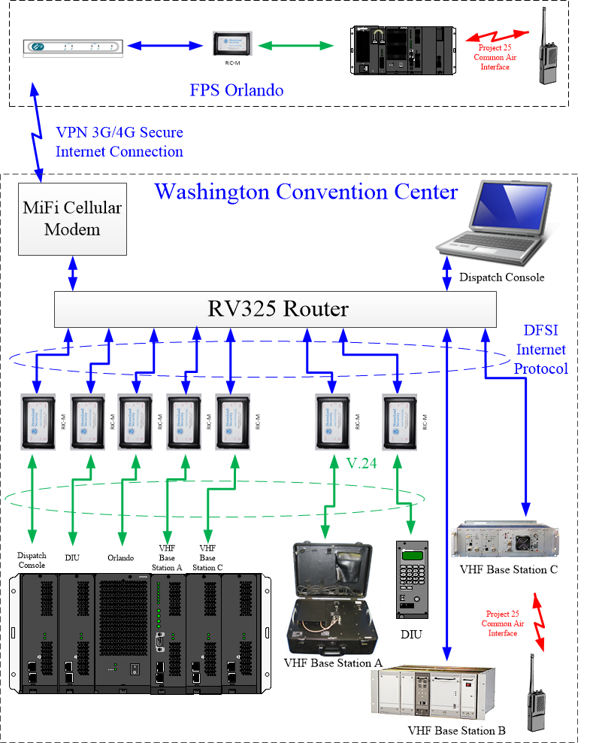
APCO 2015 Main Demonstration Table

Slide 18
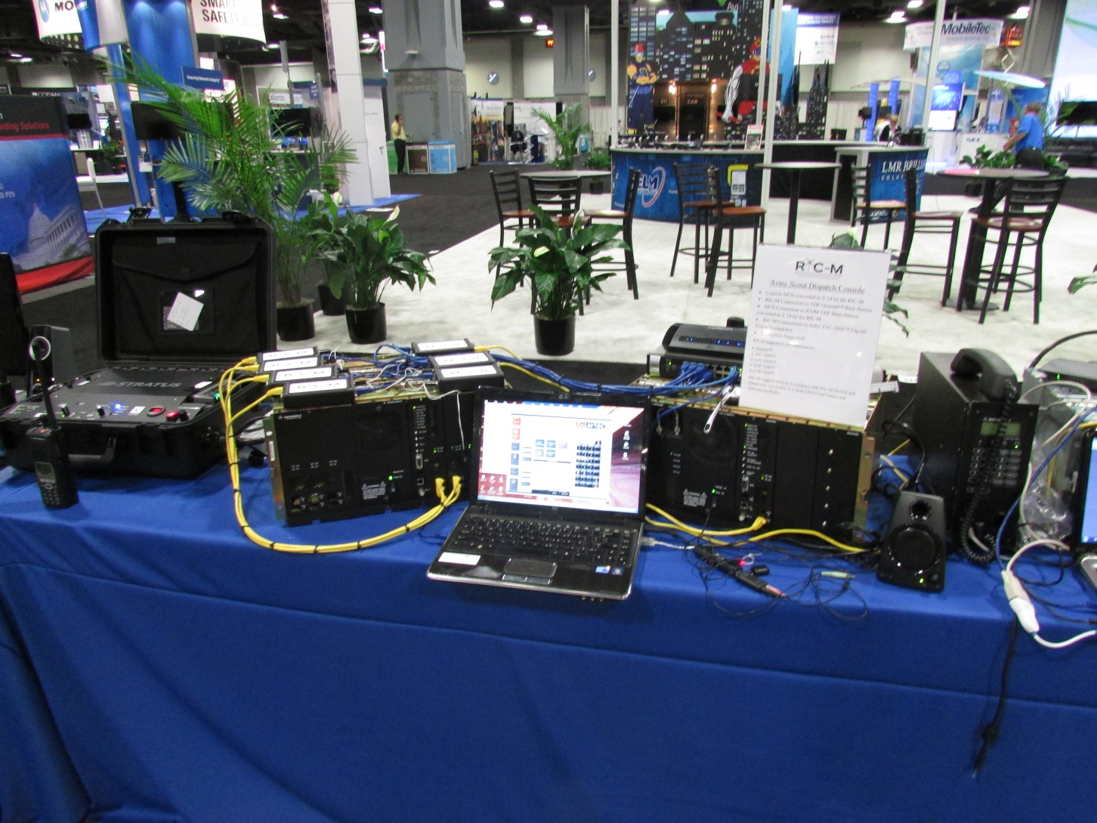
ATC-3000/Quantar™/Codan Base Station/Avtec Dispatch Console/7-RIC-Ms

Slide 19
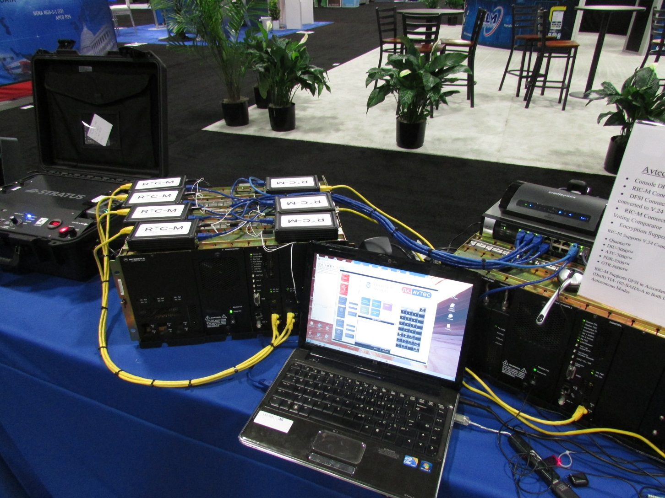
Close-up of Previous Configuration

Slide 20
RIC-M Testing
Federal Agencies: US Marshals Service, FBI, FPS, CBP, etc.
Department of Interior Radio Laboratory
Dispatch Console Manufacturers
DHS Test Report November 2013

Slide 21
RIC-M Availability
Christine Wireless, Inc. currently with access to the DHS TACCOM contract via ACG Systems in Annapolis Maryland.
Avtec, Inc. later this year (www.ric-m.com).
Potentially other US and International supply sources in future.

Slide 22
Web Resources
www.christinewireless.com
https://www.acgsys.com/product/ric-m-radio-ipcommunications-module/
http://www.firstresponder.gov/TechnologyDocuments/Conventional%20Fixed%20Station%20Interface%20Operational%20Field%20Assessment.pdf
http://www.dhs.gov/science-and-technology/can-you-hear-me-now

Slide 23
The RIC-M and the Department of the Interior (DOI)
Webinar

Slide 24
Overview
DOI operates approx. 700 independent conventional LMR networks across all 50 states and the territories
Most systems are a multi-vendor environment
We are heavily dependent of others for system transport
DOI standard for LMR systems is P25
Astro equipment exists in 80-90 % of the systems

Slide 25
Why the RIC-M matters to DOI
Migration of Microwave Networks to IP
Cost, Availability and Reliability of Legacy Curcuits
Capitalize on Existing IP Networks
RIC-M
DOI Build out of Radio IP LANs and WAN
Interconnection to other P25 Standards Based Systems
System Operations in a Multi-Vendor Environment
Extend the Life of Legacy Astro Infrastructure

Slide 26
Experiences
DOI has been involved in the development of RIC-M from the beginning
We continue to test and support the development of enhancements
Lab Testing
Field Testing

Slide 27

Federal Protective Service
Protecting People and Federal Facilities Across the Country
RIC-M

Slide 28

CARTER BLUMEYER – REGION 4
Regional Tech for Federal Protection Service
  HQ, Region 11 and Region 4
18Years as Firefighter/EMT-Boone County Fire District, Columbia MO
    Dept.'s Communication Tech
US Forest Service
  Communication Tech(COMT)
  Communication Unit Leader(COML)
FEMA Urban Search and Rescue Communication Specialist (COMS,COML)
  Deployments
    Hurricane BOB, Katrina, Charlie
    NYC 9/11-9/21
Telecommunication Specialist for FEMA MERS(Mobile Emergency Response Support)
  LMR P25 IP system integration
  Mission LMR Support for DHS/FEMA/HHS at operations
Telecommunication Specialist for CBP/US Border Patrol project
  Deployment of Digital Upgrade for Rio Grande Valley Sector (RGV)

Slide 29
Federal Protective Service Nationwide LMR Network
Responsible For Law Enforcement All Government Buildings From GSA
  200+ LMR sites
  4 Radio Dispatch Centers
  Approx. 1600 Law Enforcement Officers and 6500 Private Security Officers
FPS is in need of Transition to an IP MPLS Network From leased line
  Needs to be without interfering with daily operations
  Dispatch and LMR Equipment needs to be standards based

Slide 30
How RIC-M Is Helping FPS
Provides us with connectivity to current Stand-alone repeaters
  Using AES VPN tunnels to and from FPS NODE Sites
    Orlando Florida to Miami
    Jacksonville Florida to Miami
Plans to modernization of FPS Current Dispatch Centers to New IP Based Consoles
  RIC-M will allow the integrator make the transition smooth and seamless
    Placing RIC-M’s at FPS NODE Sites on an empty v.24 Port allows this
  The RIC-M will allow FPS to compete bid for IP standard dispatch consoles
    Saving the project funds and allowing FPS to not settle

Slide 31
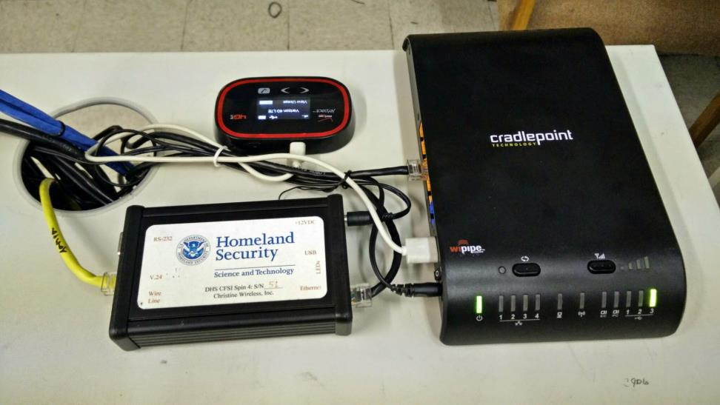
Miami NODE Connection

Slide 32
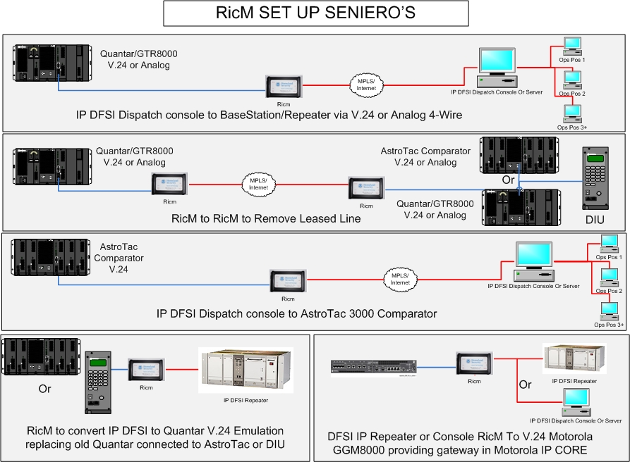

Slide 33
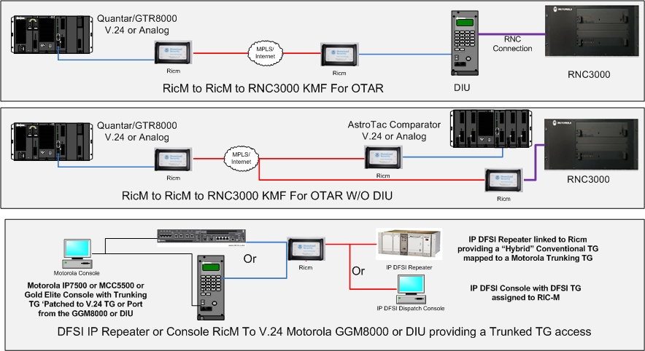

Slide 34
